Slide 1

Introduction to Robotics
2016 Fall

Slide 2
Project Roadmap
Date | Project | Finished?
9/06/16 | Introduction of Robot and Robotics, mBot Assembly | yes
9/13/16 | Introduction of mBlock | yes
9/20/16 | Play an Octave | yes
9/27/16 | Push a Button | yes
10/04/16 | Light Sensor, UltraSonic Sensor | yes
10/11/16 | Drive with Remote, Line Following | yes
10/18/16 | Robot Movement 1
10/25/16 | Robot Movement 2, Trace a Shape
11/01/16 | Obstacle Avoidance
11/08/16 | Sumo Wrestling 1
11/15/16 | Sumo Wrestling 1
11/22/16 | Maze 1
11/29/16 | Maze 2
12/06/16 | C Programming 1
12/13/16 | C Programming 2

Slide 3
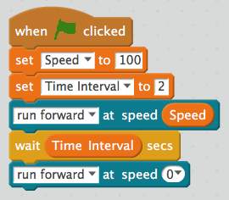
Linear Motion Calibration:
Speed-Time-Distance in cm
Speed | 2 sec | Cm/Sec
100
150
200

Slide 4
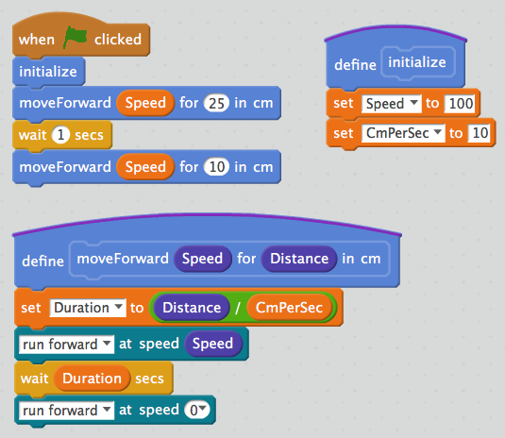
Project: Controlling Movement Distance
The requirements for this program are:
1. The mBot shall move forward 25cm.
2. The mBot shall pause for one second after the first movement.
3. The mBot shall move forward 10cm.
4. The mBot shall stop.

Slide 5
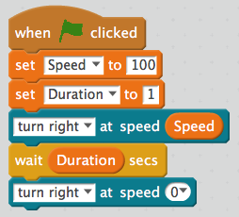
Speed-Time for 360º turn
Speed | Time for 360º in Seconds
100
150
200

Slide 6
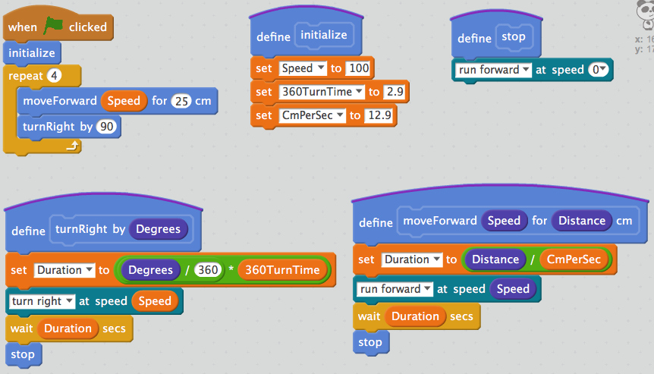
Project: Trace a Square
The requirements for this program are:
1. The robot shall move forward 25cm.
2. The robot shall execute a 90° turn.
3. The robot shall repeat these operations until it returns to the starting point.

Slide 7
Challenges
1. Modify the program to trace the outline of a triangle.
2. Modify the program to trace the outline of a pentagon.
3. Modify the program to trace the outline of a hexagon.
4. Modify the program to trace the outline of an octagon.

Slide 8
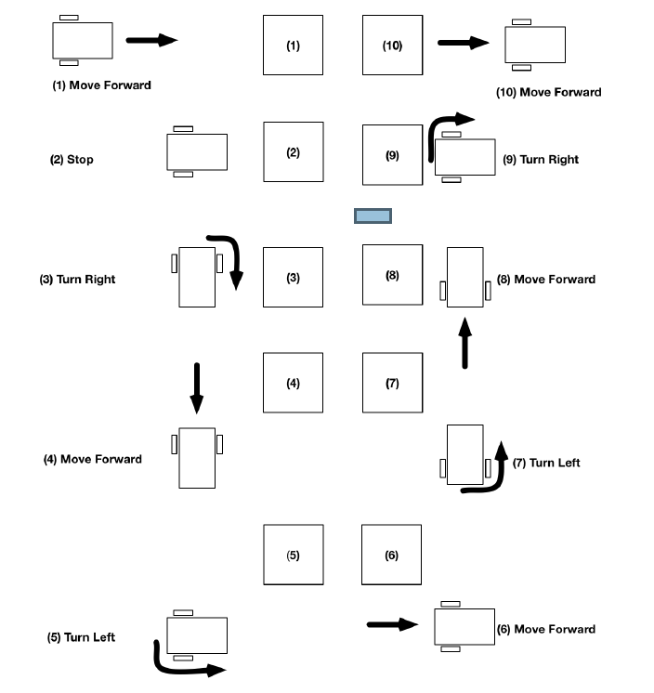
Obstacle Avoidance

